Slide 1
Category review: Chips
Feb 2025
Retail Analytics
Presented by: SATHISH KUMAR
Brand note: If client logo is not required, use alternate title page layout right click slide thumbnail > Layout > Title

Slide 2
Notes:
To view Privacy video explaining how important data privacy is to Quantium, please click here: https://www.youtube.com/watch?v=Zq1QDAkoRzU
or here Q:\Company Reference\Brand & Design\Brand videos\Q Privacy.mp4
At Quantium, we believe that data is the behavioural footprint of humanity and that it has to be treated with the utmost care and responsibility.
Histories, attitudes, indeed lives are stored within it in ways that aren’t always apparent – and that’s what makes its potential so powerful.
To work with it responsibly, sensitively, we set ourselves the highest data privacy protection and governance standards.
We have spent 17 years perfecting privacy-by-design and secure-by-design principles. Central to this is not holding any personally identifiable information about people –
we neither receive it, and put the necessary protections in place to be unable to decipher it.
Every aspect of handling data is safeguarded: from its de-identification, to its encryption – data security is paramount and of the highest grade.
We pride ourselves on gaining the trust of iconic organisations around the world through years of securely working with their data,
and in turn the trust that builds with their stakeholders.

Slide 3
Executive summary
Objective:
Evaluate the impact of a new store layout on chip sales.
Key Insights:
Identified top customer segments.
Analyzed purchase behaviors and sales trends.
Measured trial store performance against control stores.
Derived actionable recommendations for strategy improvement.
Conclusion:
The new store layout showed a positive impact on sales, particularly in Stores 77 & 88.

Slide 4
Category Review (Task 1 Summary)
Top Customer Segments:
Budget Older Families
Mainstream Retirees
Mainstream Young Singles & Couples
Key Sales Drivers:
Number of customers (for Mainstream Retirees & Young Singles/Couples)
Chips purchased per customer (for Budget Older Families)
Popular Products:
Brands: Kettle, Smiths, Doritos, Pringles
Pack Sizes: 175g, 150g, 134g, 110g, 170g
Seasonal Insights:
Sales spike before Christmas → opportunity for promotions.

Slide 5
Trial Store Analysis (Task 2 Summary)
Trial Stores: 77, 86, 88
Control Stores: 233, 155, 237
Performance Analysis:
Stores 77 & 88: Showed positive uplift, validating the new layout.
Store 86: Showed positive uplift, though slightly lower compared to Store 77.
Conclusion: Trial successfully demonstrated a positive impact on chip sales uplift.

Slide 6
01
Category

Slide 7
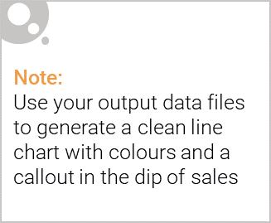
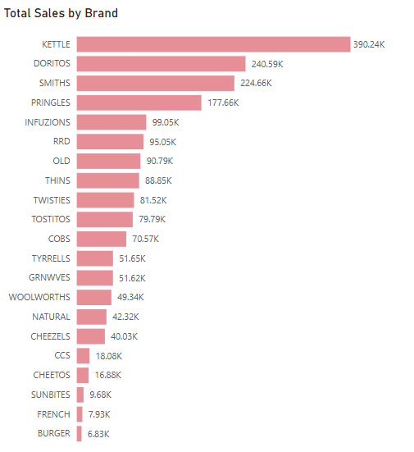
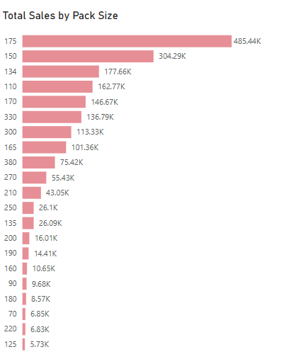
Sales Analysis

Slide 8

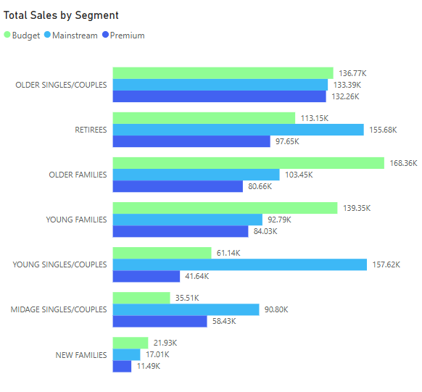
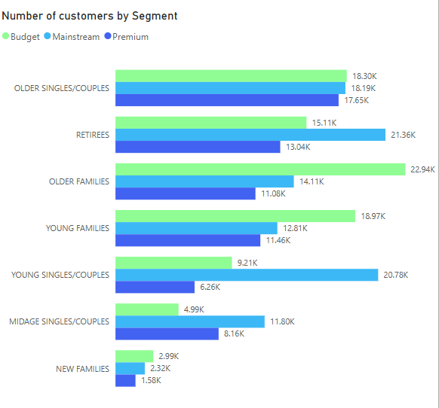

Slide 9
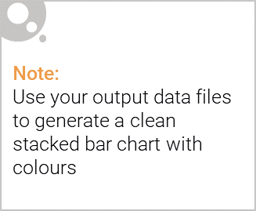
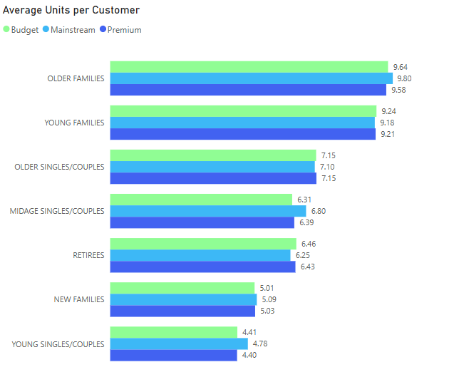
Editable (delete this)

Slide 10
02
Trial store performance

Slide 11
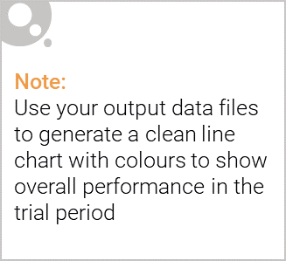
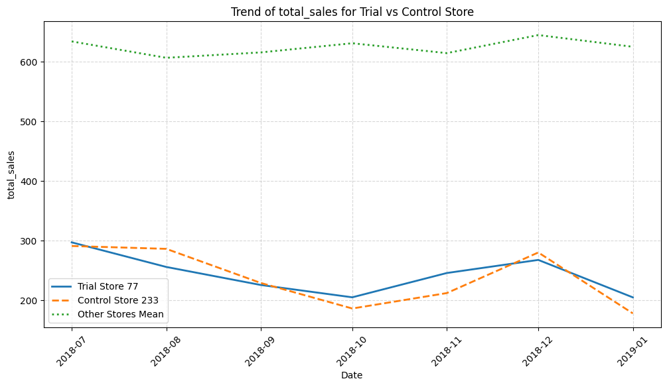
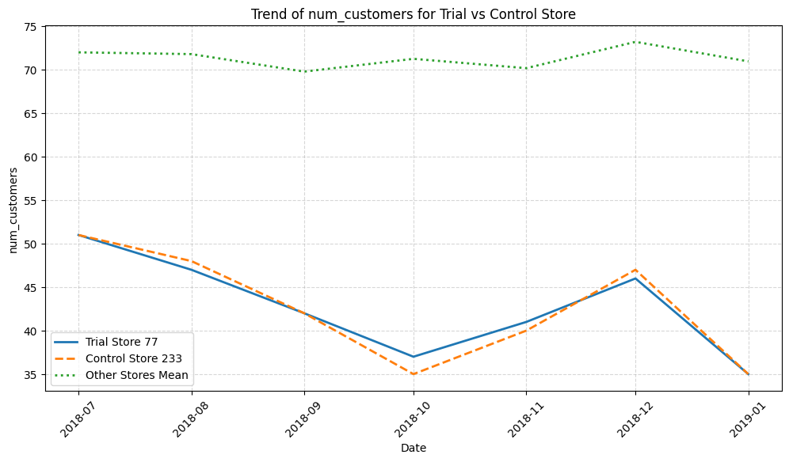
Store 77 (Trial), Store 233 (Control), and other stores Pre-trial period

Slide 12
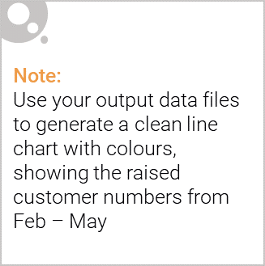
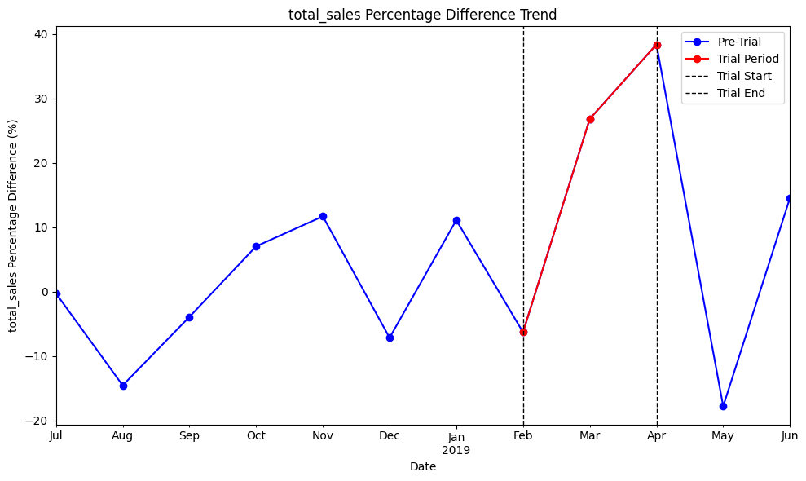
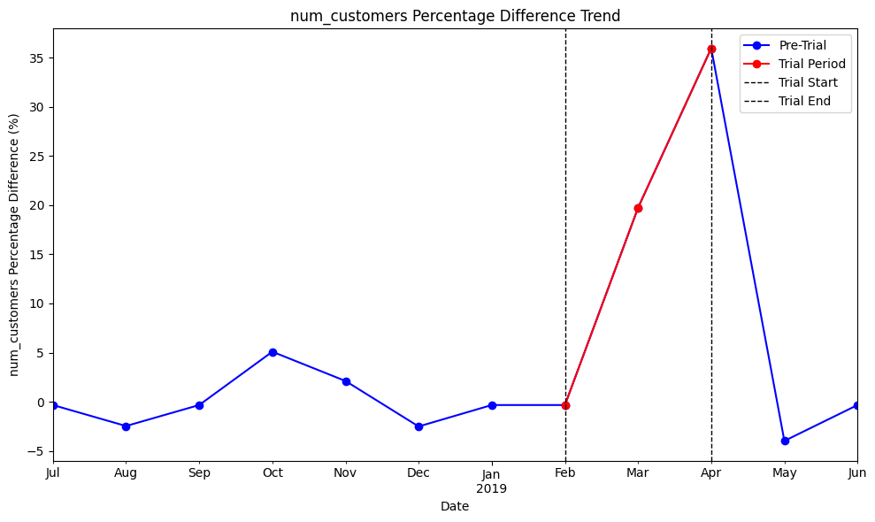
The percentage difference in performance between 77 and 233 is positively affected by the experiment

Slide 13
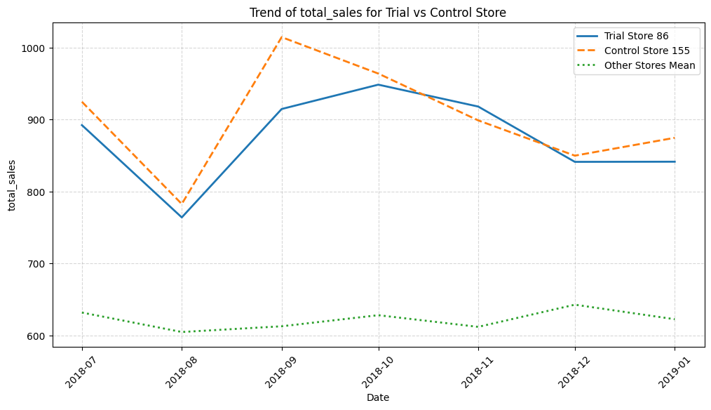
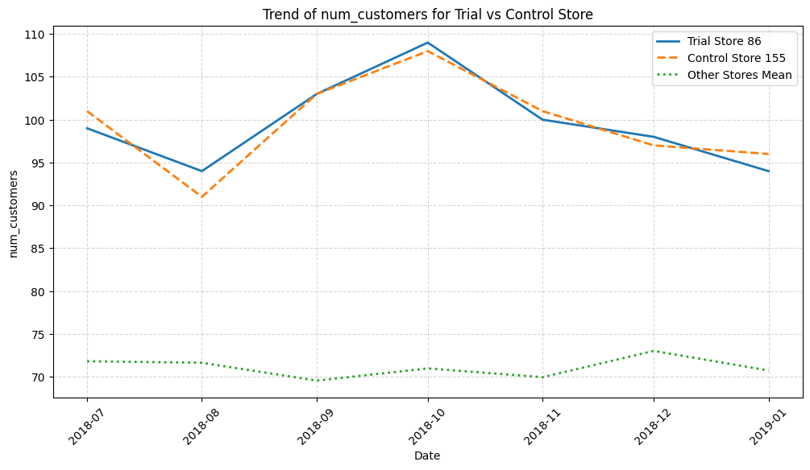
Store 86 (Trial), Store 155 (Control), and other stores Pre-trial period

Slide 14
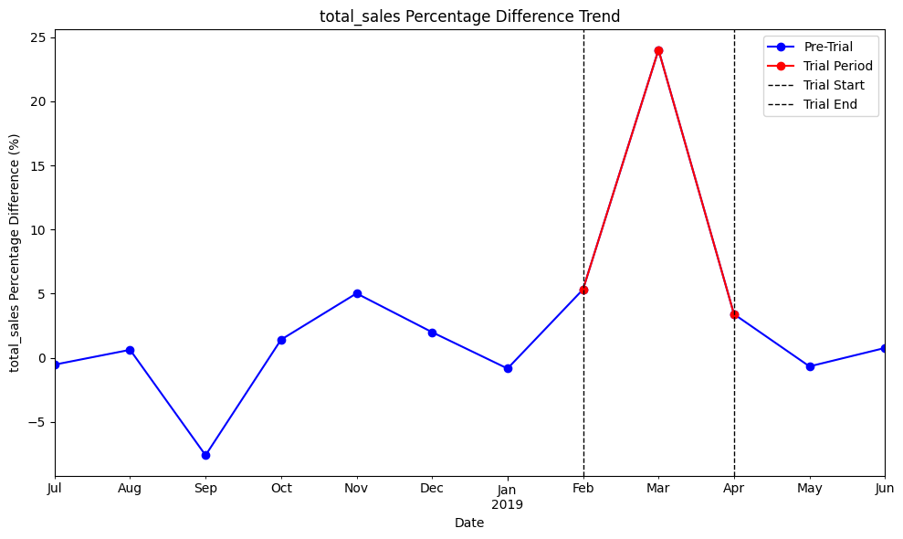
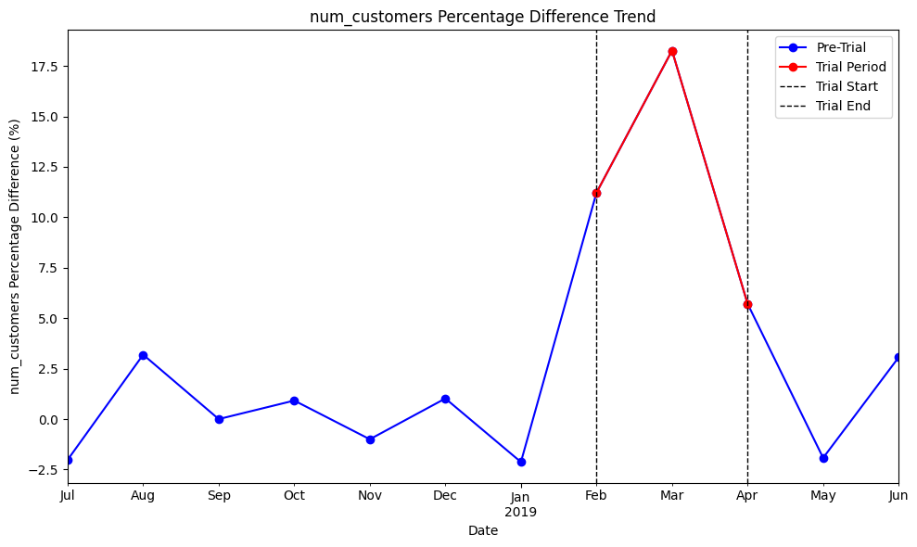
The experiment had a mixed effect on the performance of store 86 (trial) when compared to Store 155 (control).

Slide 15
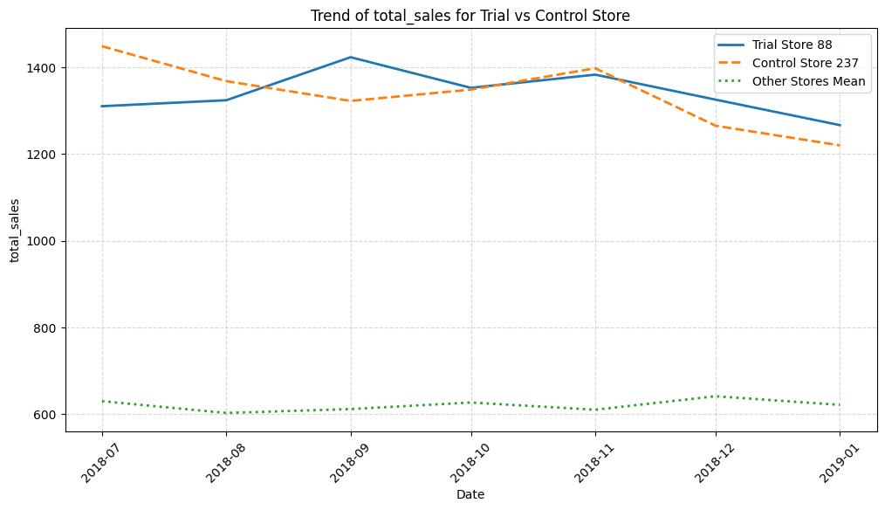
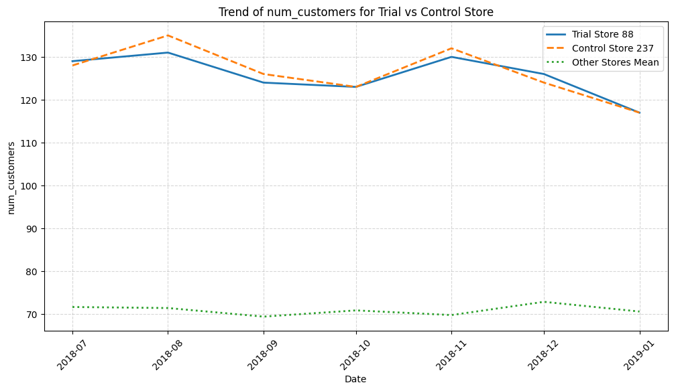
Store 88 (Trial), Store 237 (Control), and other stores Pre-trial period

Slide 16
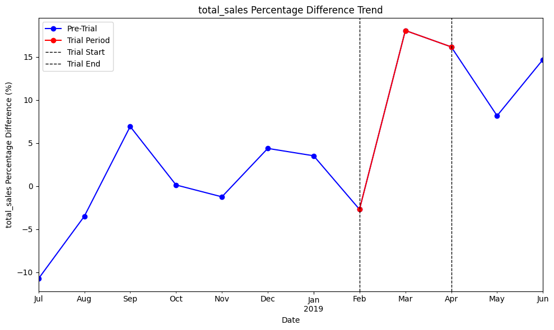
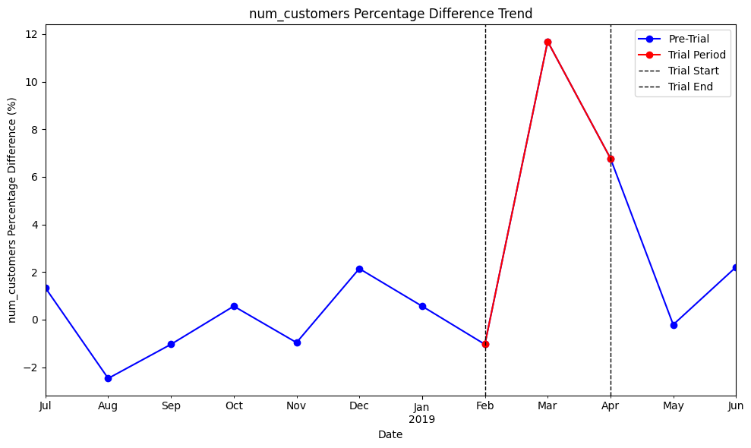
The percentage difference in performance between 88 (trial) and 237 (control) is positively affected by the experiment

Slide 17
Key Findings & Overall Impact
1. Increase in Total Sales Across Trial Stores
Store 77: +23.83% sales increase vs. control store.
Store 86: +10.91% sales increase vs. control store.
Store 88: +12.32% sales increase vs. control store.
Conclusion: The intervention positively impacted sales, with Store 77 experiencing the highest increase.
2.Growth in Number of Customers
Store 77: +18.67% customer increase vs. control store.
Store 86: +11.73% customer increase vs. control store.
Store 88: +6.50% customer increase vs. control store.
Conclusion: More customers visited the trial stores, indicating improved foot traffic and brand engagement.

Slide 18
Key Findings & Overall Impact
3. Effectiveness of Control Stores for Comparison
Pre-trial differences between trial and control stores were small, ensuring a valid comparison.
Control stores followed similar customer and sales trends before the trial, confirming that differences observed during the trial were due to the intervention.
Conclusion: The control stores were well-matched, making the results statistically reliable.
Overall Impact of the Trial
The intervention led to higher sales and customer traffic in all three trial stores.
The most significant improvement was seen in Store 77, suggesting that the trial was highly effective in that location.
The results confirm that scaling this intervention to other stores could yield similar benefits.

Slide 19
Final Verdict:
The trial successfully boosted both sales and customer visits, proving its effectiveness. Further expansion and optimization are recommended

